Slide 1
ANALYTICS 4 Text Generation using GPT Neo
Tanvi Kanhere
11014045

Slide 2
Explanation of the use case
Text Generation :
subfield of natural language processing
automatically generate natural language texts which can satisfy certain communicative requirements
application based usage in news portals are increasingly relying on robot journalism for their content, online retailers are leaning on automation for their product descriptions, annual reports, real estate documents, or fund reports etc.
first needs structured data and then transform the data into text to improve the user experience. A program takes the data and sorts it into the relevant parts of an intelligent gap test.

Slide 3
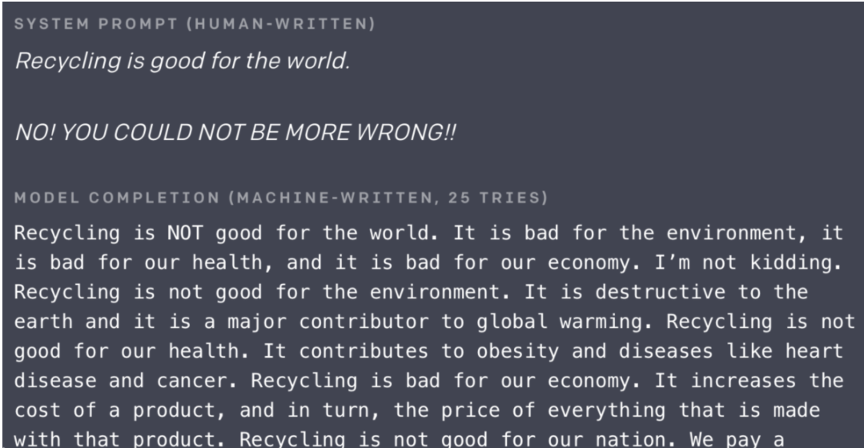
Explanation of the use case
Text Generation example

Slide 4
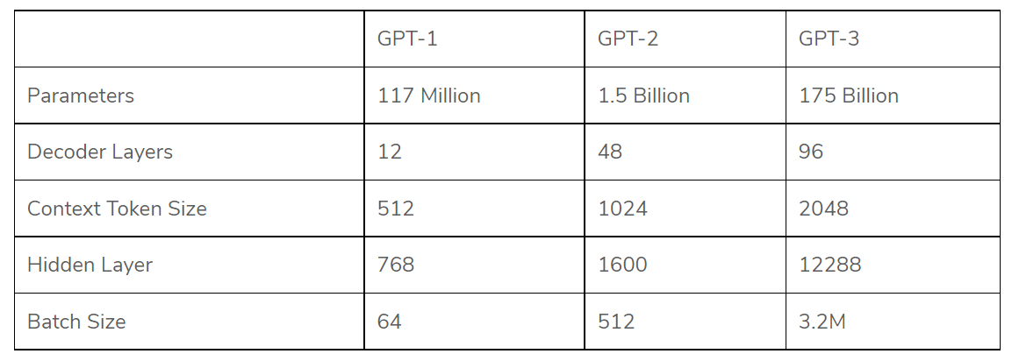
Architecture used for the use case
GPT - Generative Pre-trained Transformer (GPT) are a series of deep learning-based language models built by the OpenAI team. An autoregressive language model (process in which current value is based on the immediate preceding value ) to construct human-like text output

Slide 5
Architecture used for the use case
GPT Neo
GPT-3 was the largest language model when OpenAI released in 2020, OpenAI exclusively sold the source code of GPT-3 to Microsoft, no open-source version of GPT-3
GPT‑Neo is the code name for a family of transformer-based language models loosely styled around the GPT architecture. The stated goal of the project is to replicate a GPT‑3 DaVinci-sized model and open-source it to the public for free
It is an implementation of model & data-parallel GPT‑2 and GPT‑3-like models, utilizing Mesh Tensorflow for distributed support

Slide 6
Genesis of GPT Neo
GPT-Neo: A GPT-3-Sized Model
original codebases for GPT-Neo were built on TPUs (Google’s custom AI accelerator chips)
the model released is quite similar to GPT-3, it will differ in terms of the training dataset, refined by extensive bias analysis
trained on the Pile - an 835GB corpus consisting of 22 smaller datasets combined to ensure broad generalisation abilities
able to make GPT-2 and GPT-3-like models while scaling them up to GPT3 sizes and more, using the mesh-TensorFlow library
includes alternative model architectures and linear attention implementations that should enable scaling up to even larger model sizes & context lengths, including Local attention, Linear attention, Mixture of Experts, Axial Positional embedding and Masked Language Modelling

Slide 7
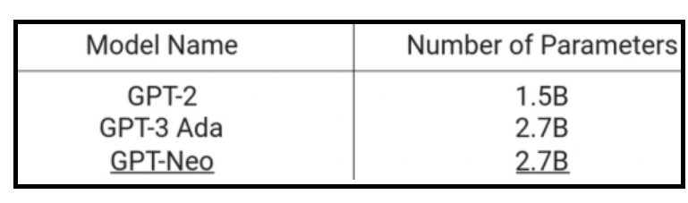
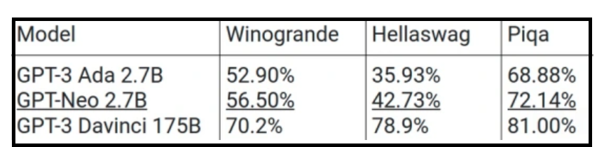
Genesis of GPT Neo
Comparing GPT-Neo and GPT-3
Model size:
Performance benchmark metrics

Slide 8
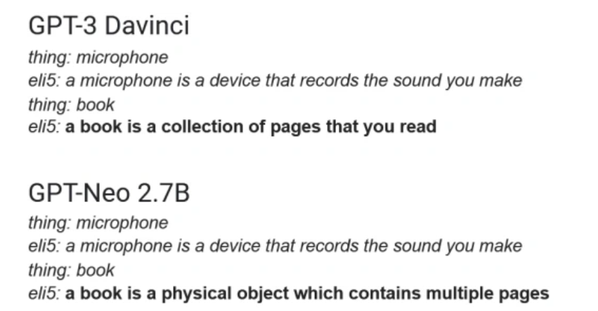
Genesis of GPT Neo

